Slide 1
Machine Learning Techniques for Chemical Toxicity Prediction
Mariia Makarova

Slide 2
Significance of Toxicity Prediction
Toxicity refers to the degree to which a chemical substance or a particular mixture of substances can damage an organism.
Public Health: Identifying toxic compounds helps prevent human exposure to harmful chemicals.
Environmental Protection: Preventing the release of toxic substances into the environment protects ecosystems.
Regulatory Compliance: Ensuring products meet safety standards set by regulatory agencies.
Drug Development: Identifying potential toxicity in new drugs early in the development process to avoid costly failures in later stages.
2

Slide 3
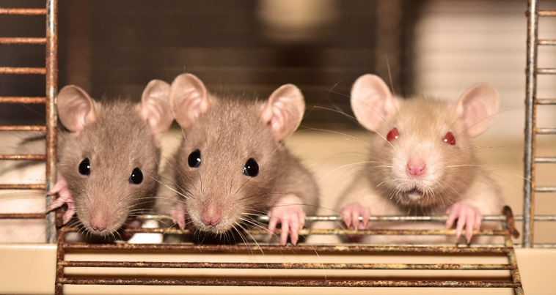
Challenges in Toxicity Prediction
Traditional methods rely on extensive laboratory testing and animal studies, which are time-consuming, costly, and ethically challenging.
There is a need for more efficient and reliable methods to predict toxicity.
3

Slide 4
The Role of Machine Learning
Efficiency: Machine learning models can analyze vast datasets quickly, identifying patterns and making predictions faster than traditional methods.
Accuracy: Advanced algorithms can improve prediction accuracy by learning from complex data.
Scalability: Machine learning can handle large-scale data, making it suitable for evaluating numerous compounds.
Machine Learning in Toxicity Prediction:
Data-Driven: Utilizes chemical structure data and known toxicity outcomes to train predictive models.
Feature Extraction: Derives meaningful features from chemical compounds (e.g., molecular weight, lipophilicity) to inform predictions.
Predictive Modeling: Applies algorithms to predict the likelihood of toxicity in new compounds.
4

Slide 5
Goals of the Project
Explore the Dataset
Conduct a thorough analysis of the dataset to understand its structure, characteristics, and key features.
Identify and preprocess relevant data, including feature extraction from chemical compounds.
2. Build Predictive Models
Develop various machine learning models to predict the toxicity of chemical compounds.
3. Compare Model Performance
Evaluate and compare the performance of different models using appropriate metrics such as accuracy, precision, recall, and F1 score.
4. Run Predictions
Apply the best-performing model to predict the toxicity of new, unseen chemical compounds.

Slide 6
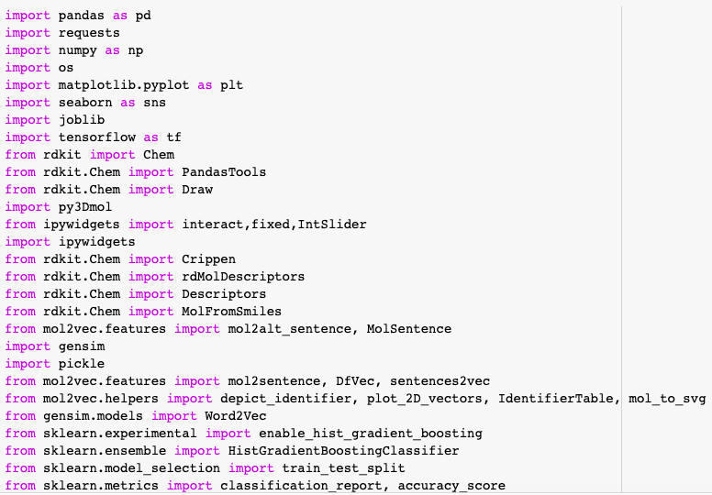
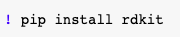
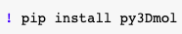
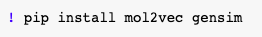
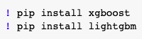
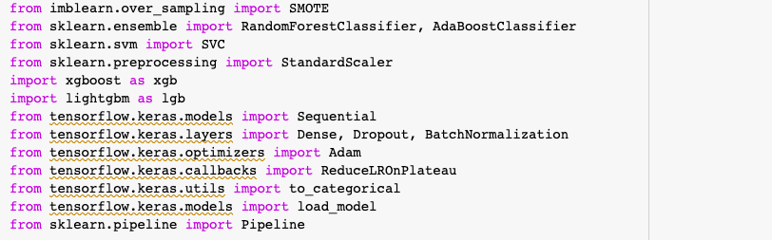
Imports: Libraries and Packages

Slide 7
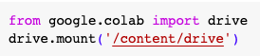
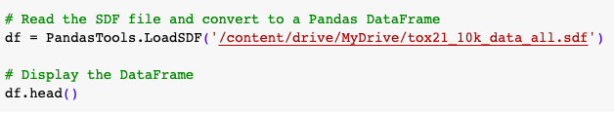
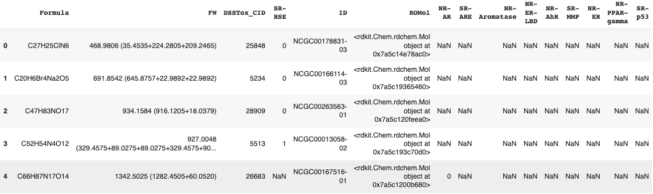
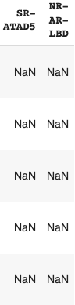
Dataset
7

Slide 8
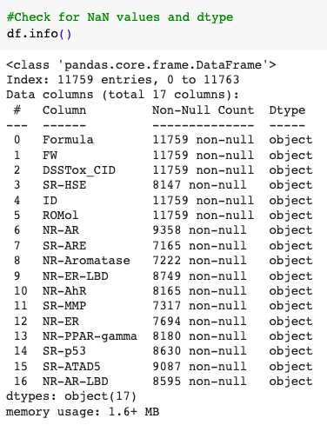
Dataset Analysis
8

Slide 9
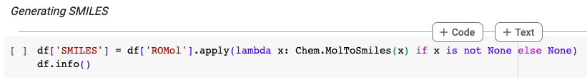
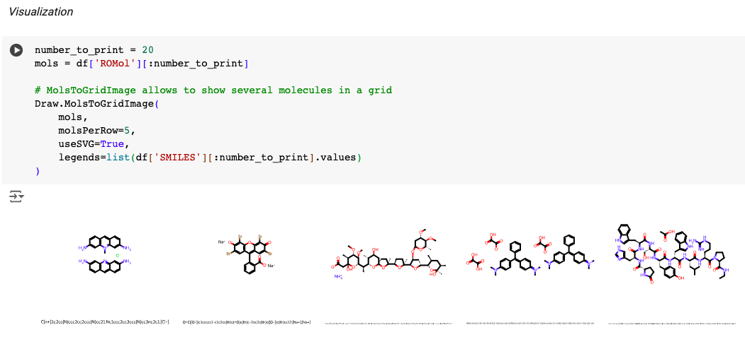
Dataset Analysis
9

Slide 10
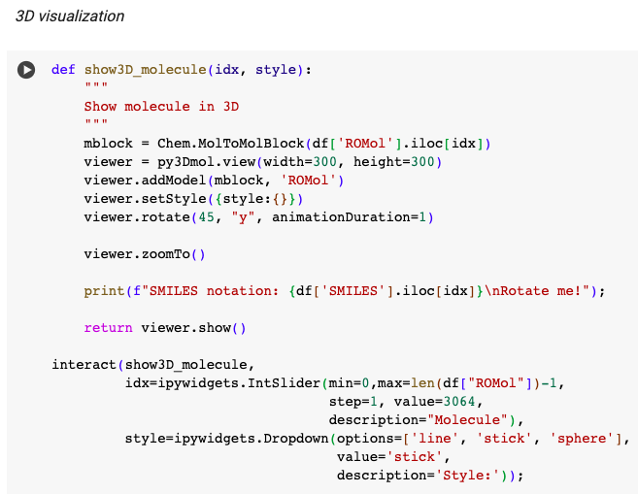
Dataset Analysis
10

Slide 11
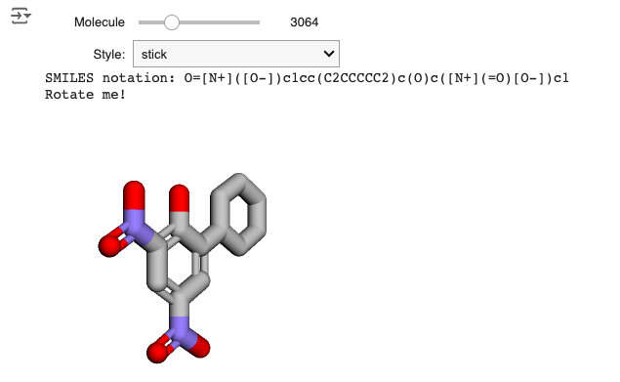
Dataset Analysis
11

Slide 12
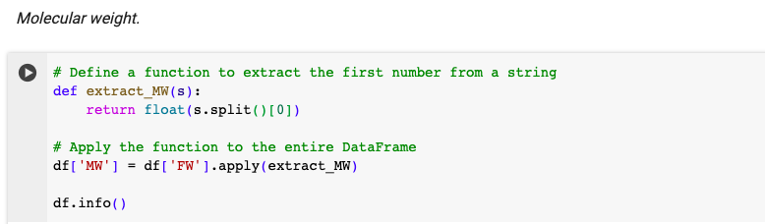
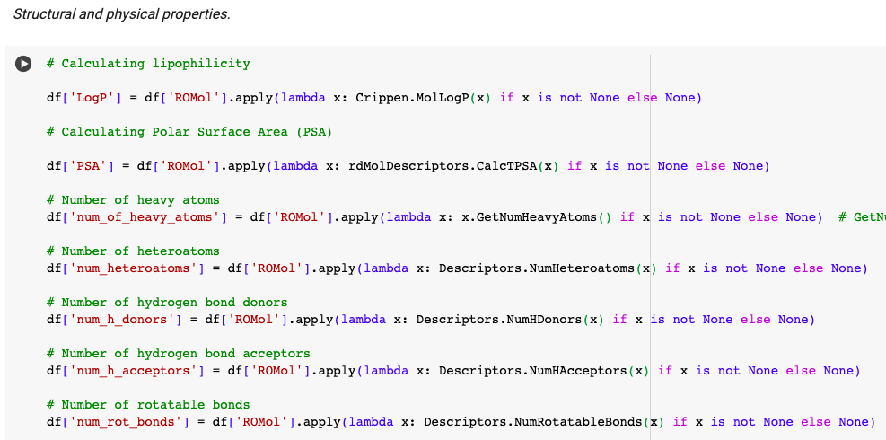
Feature Engineering
12

Slide 13
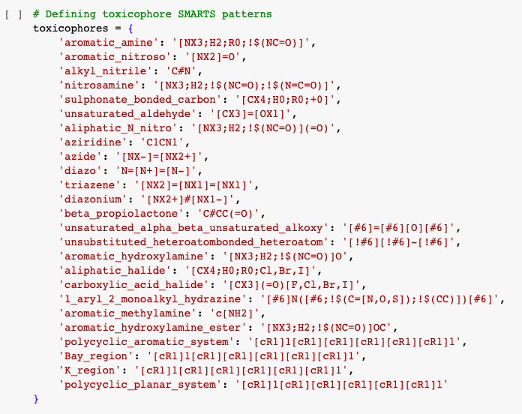
Feature Engineering
13

Slide 14
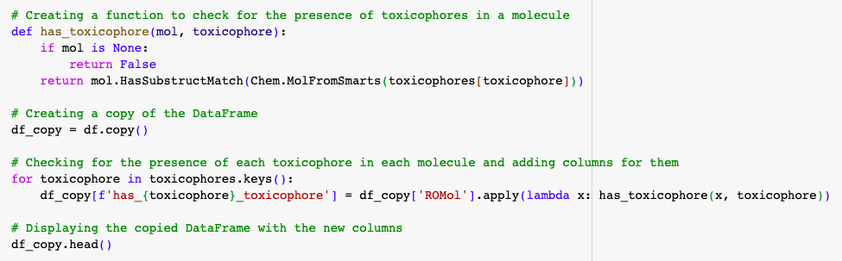
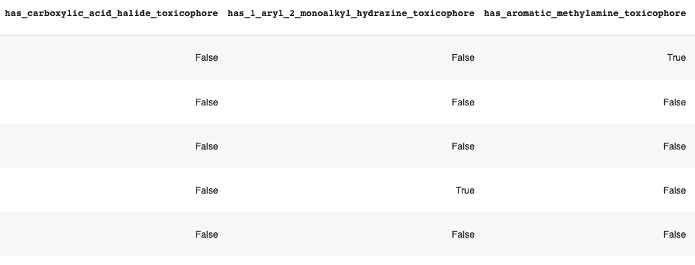
Feature Engineering
14

Slide 15
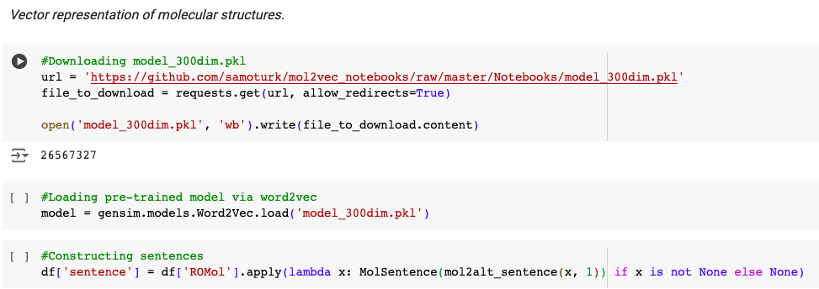
Feature Engineering
15

Slide 16
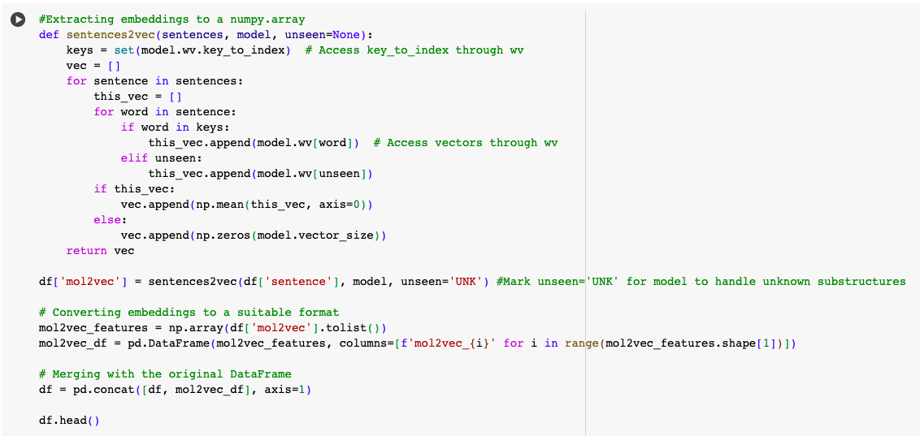
Feature Generation
16

Slide 17
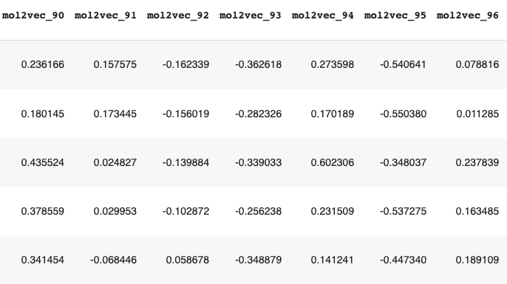
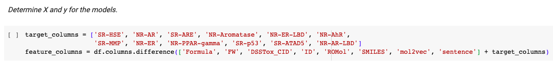
Feature Engineering
17

Slide 18
Prediction Models
HistGradientBoostingClassifier
HistGradientBoostingClassifier with weights
HistGradientBoostingClassifier using SMOTE
Random Forest
AdaBoost
XGBoost
LightGBM
SVM
Neural Network (FNN)
18

Slide 19
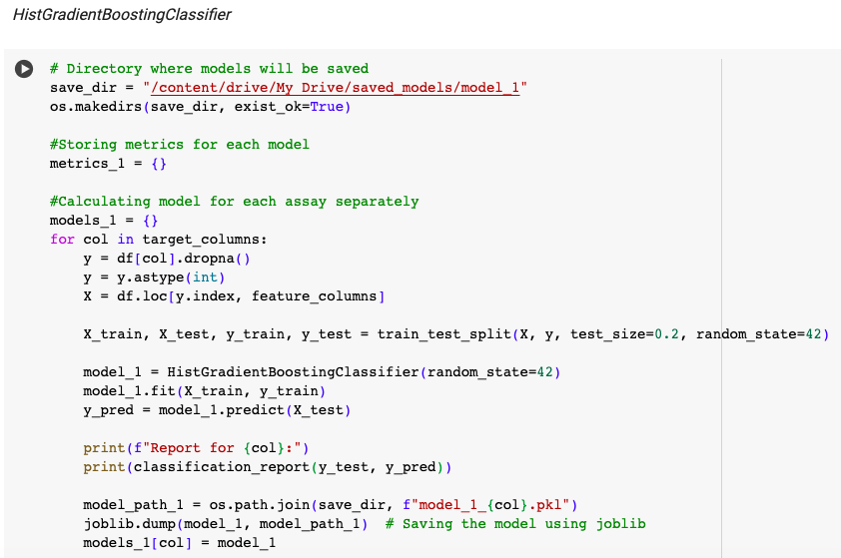
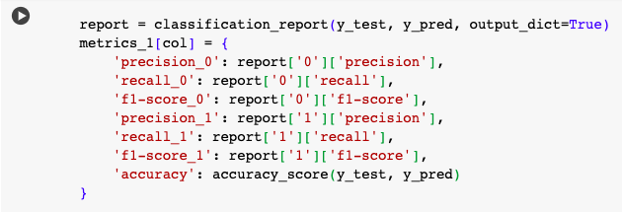
HistGradientBoostingClassifier
19

Slide 20
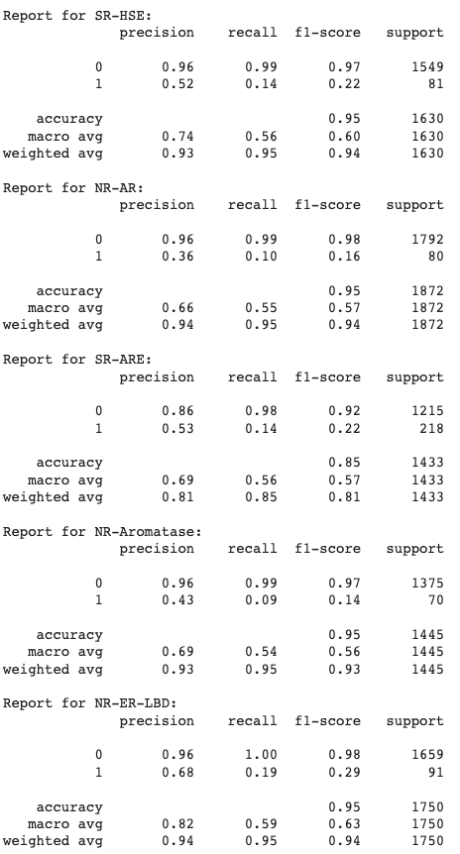
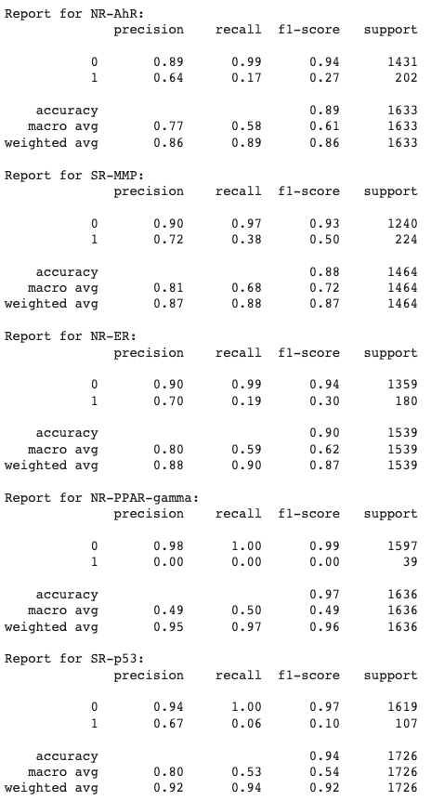
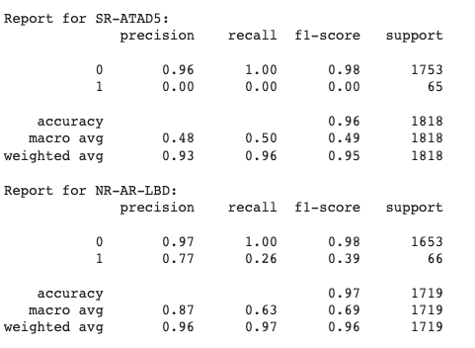
HistGradientBoostingClassifier
20

Slide 21
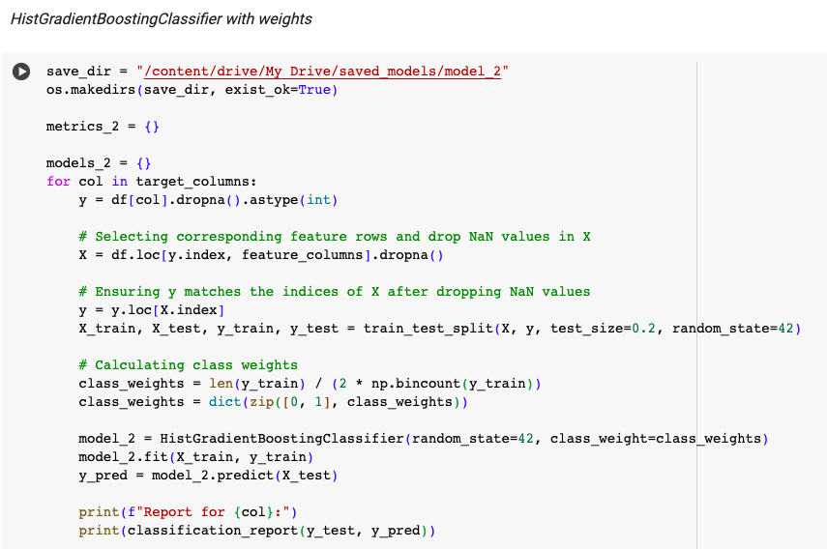
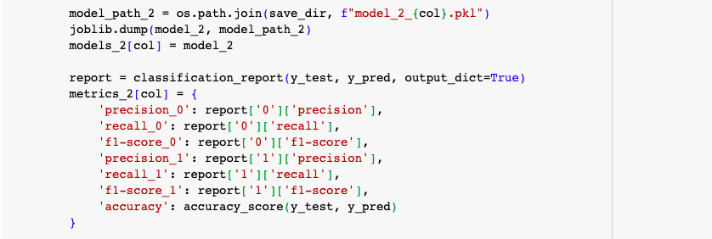
HistGradientBoostingClassifier
21

Slide 22
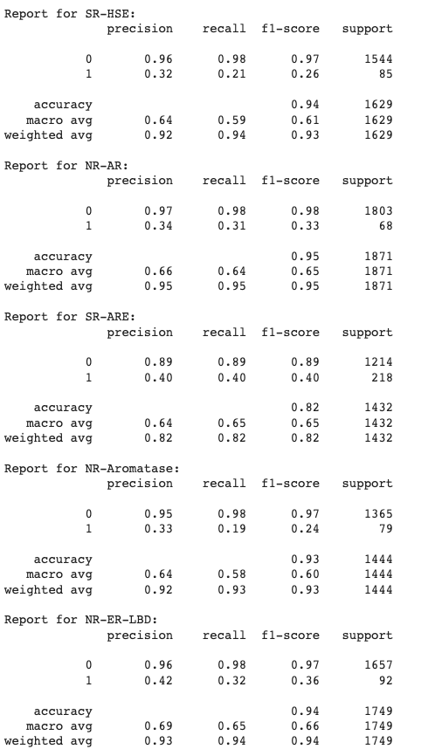
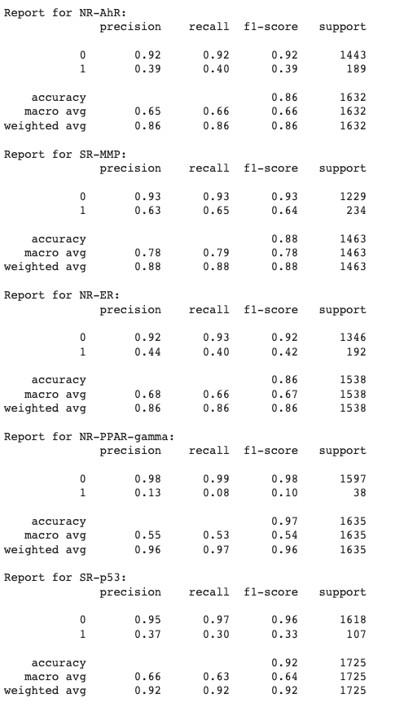
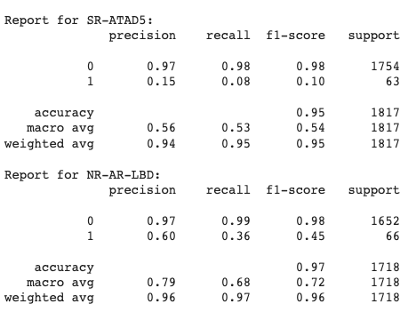
HistGradientBoostingClassifier
22

Slide 23
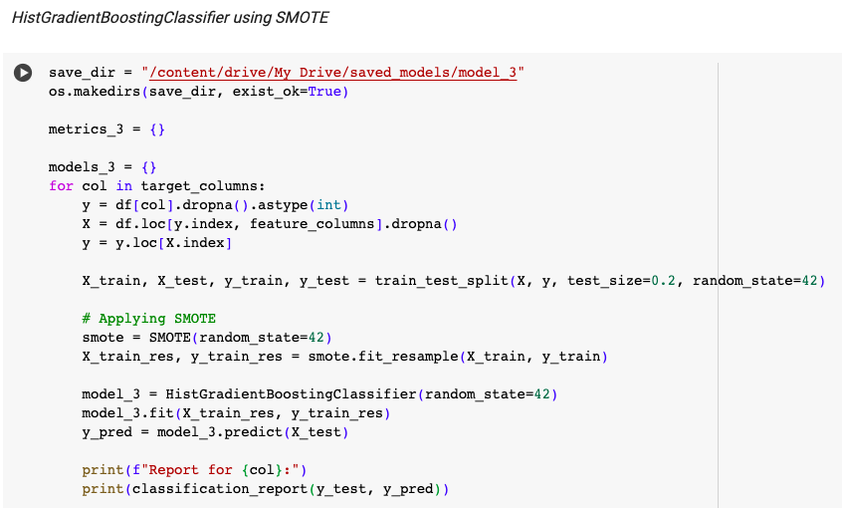
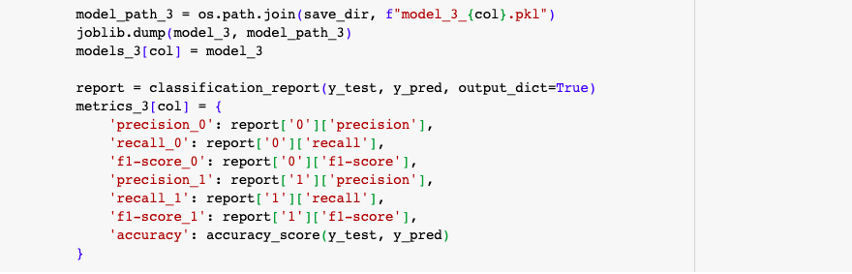
HistGradientBoostingClassifier
23

Slide 24
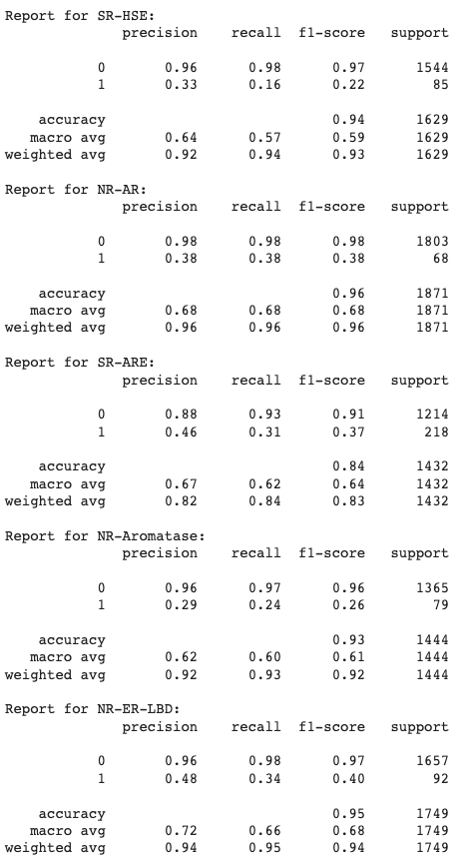
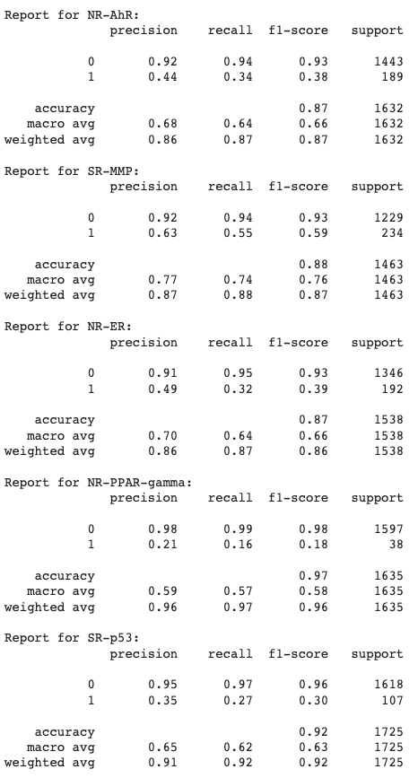
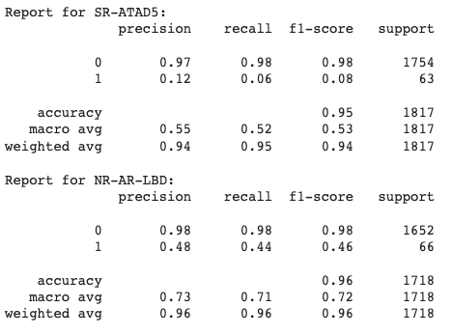
HistGradientBoostingClassifier
24

Slide 25
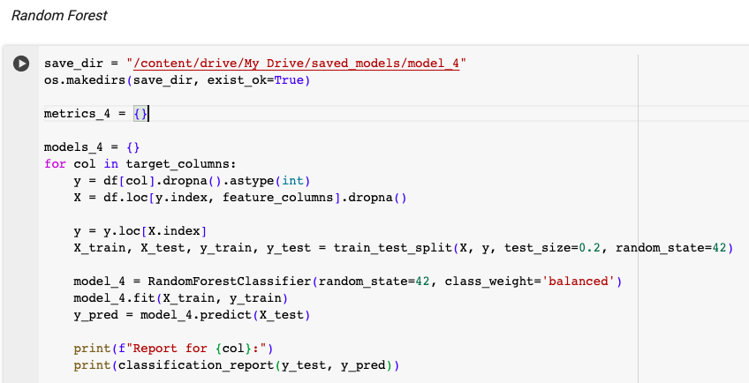
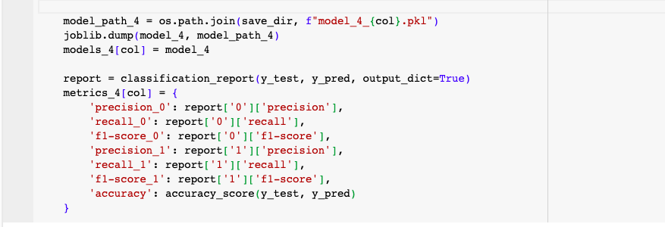
Random Forest
25

Slide 26
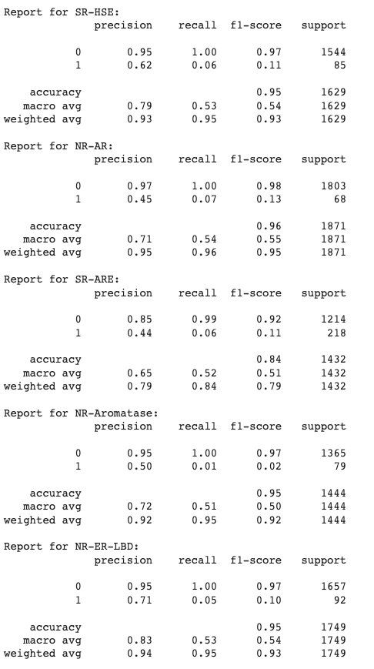
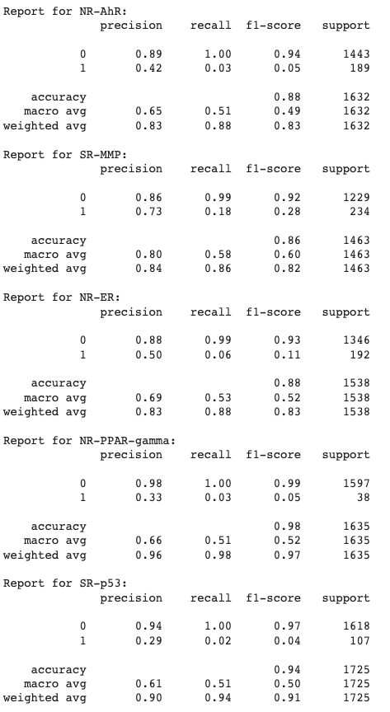
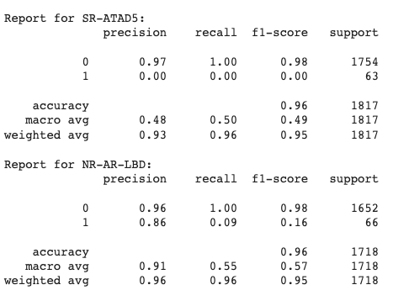
Random Forest
26

Slide 27
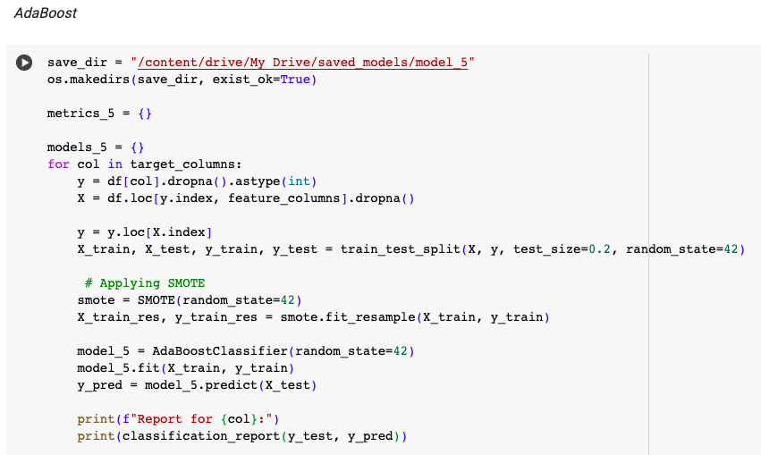
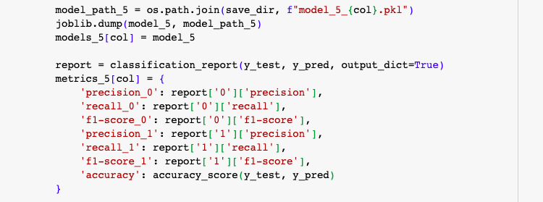
AdaBoost
27

Slide 28
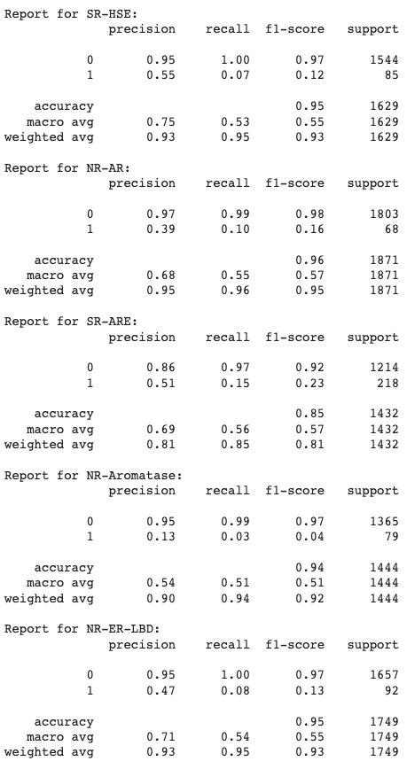
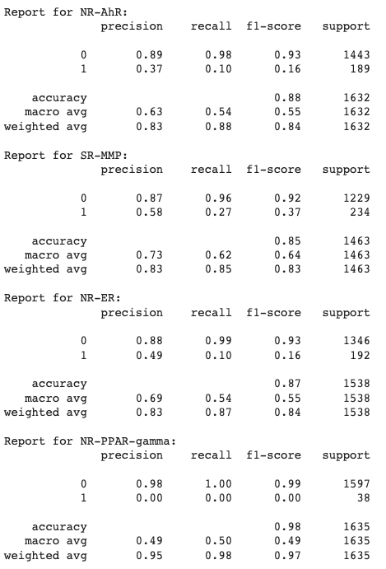
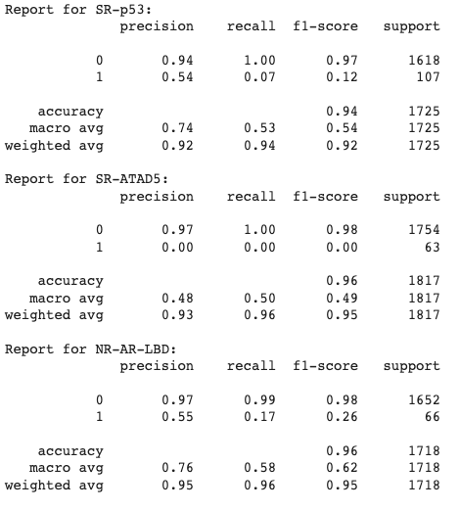
AdaBoost
28

Slide 29


SVM
29

Slide 30



SVM
30

Slide 31


XGBoost
31

Slide 32



XGBoost
32

Slide 33


LightGBM
33

Slide 34












LightGBM
34

Slide 35

FNN
35

Slide 36

FNN
36

Slide 37

FNN
37

Slide 38












FNN
38

Slide 39

Prediction Models Summary
39

Slide 40

Prediction Models Summary
40

Slide 41

Prediction Models Summary
41

Slide 42

Prediction Models Summary
42

Slide 43

Prediction Models Summary
43

Slide 44

Prediction Models Summary
44

Slide 45
Precision vs. Recall
Drug Development: High precision is generally better to avoid unnecessary costs and focus resources on truly toxic compounds.
Random Forest, XGBoost, AdaBoost, LightGBM, HistGradientBoostingClassifier
Clinical Studies: High recall is generally better to ensure comprehensive safety and protect patients from potential toxic effects.
SVM, Neural Network (FNN)
45

Slide 46

Plot examples
46

Slide 47






Plot examples
47

Slide 48

Predictions
48

Slide 49

Predictions
49

Slide 50

Predictions
50

Slide 51

Predictions
51

Slide 52

Predictions
52

Slide 53
Thank you!
53

